Slide 1
Chapter 3
Arithmetic for Computers

Slide 2
Arithmetic for Computers
§3.1 Introduction
Operations on integers
Addition and subtraction
Multiplication and division
Dealing with overflow
Floating-point real numbers
Representation and operations

Slide 3
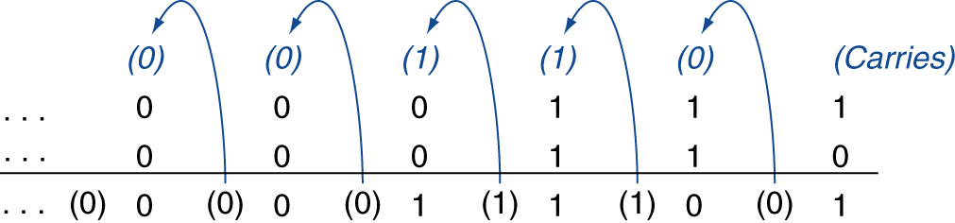
Integer Addition
Example: 7 + 6
§3.2 Addition and Subtraction
Overflow if result out of range
Adding +ve and –ve operands, no overflow
Adding two +ve operands
Overflow if result sign is 1
Adding two –ve operands
Overflow if result sign is 0

Slide 4
Integer Subtraction
Add negation of second operand
Example: 7 – 6 = 7 + (–6)
+7: 0000 0000 … 0000 0111 –6: 1111 1111 … 1111 1010 +1: 0000 0000 … 0000 0001
Overflow if result out of range
Subtracting two +ve or two –ve operands, no overflow
Subtracting +ve from –ve operand
Overflow if result sign is 0
Subtracting –ve from +ve operand
Overflow if result sign is 1

Slide 5
Dealing with Overflow
Some languages (e.g., C) ignore overflow
Use MIPS addu, addui, subu instructions
Other languages (e.g., Ada, Fortran) require raising an exception
Use MIPS add, addi, sub instructions
On overflow, invoke exception handler
Save PC in exception program counter (EPC) register
Jump to predefined handler address
mfc0 (move from coprocessor reg) instruction can retrieve EPC value, to return after corrective action

Slide 6
Arithmetic for Multimedia
Graphics and media processing operates on vectors of 8-bit and 16-bit data
Use 64-bit adder, with partitioned carry chain
Operate on 8×8-bit, 4×16-bit, or 2×32-bit vectors
SIMD (single-instruction, multiple-data)
Saturating operations
On overflow, result is largest representable value
c.f. 2s-complement modulo arithmetic
E.g., clipping in audio, saturation in video

Slide 7
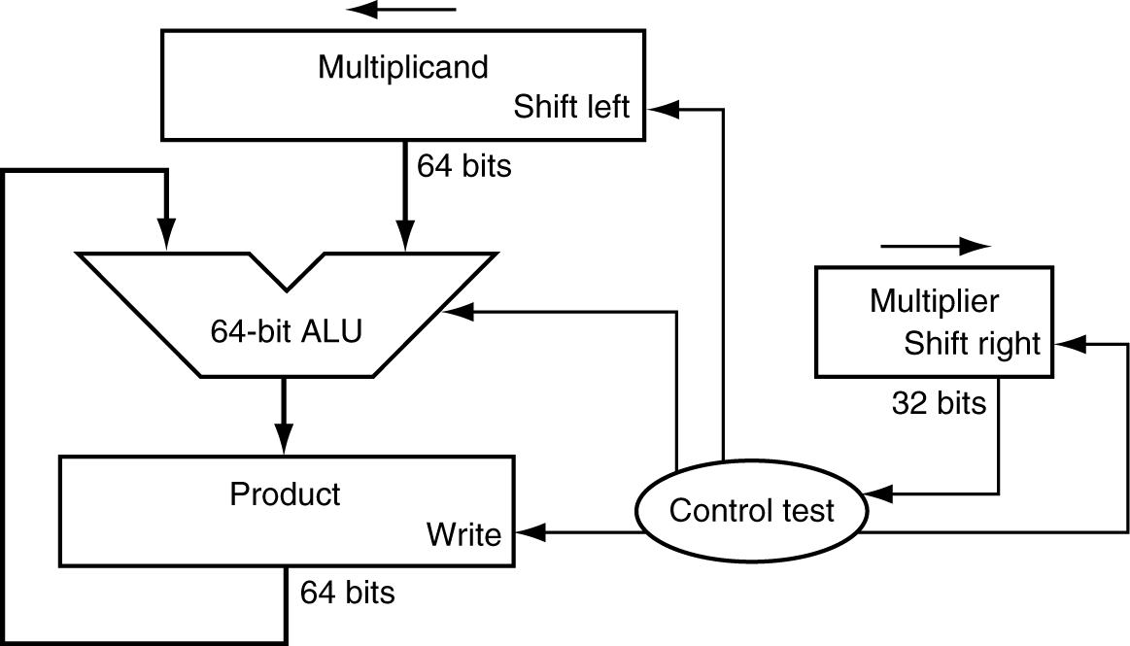
Multiplication
§3.3 Multiplication
Start with long-multiplication approach
multiplicand
1000
× 1001
1000
0000
0000
1000
1001000
multiplier
product
Length of product is the sum of operand lengths

Slide 8
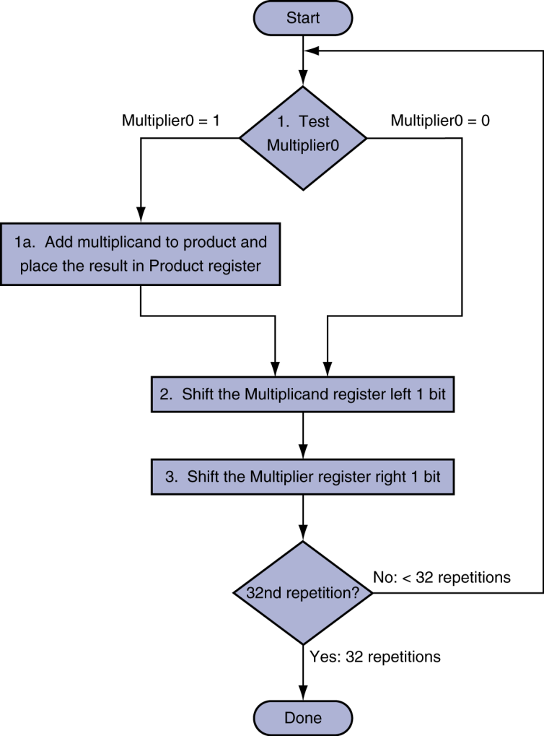
Multiplication Hardware
Initially 0

Slide 9
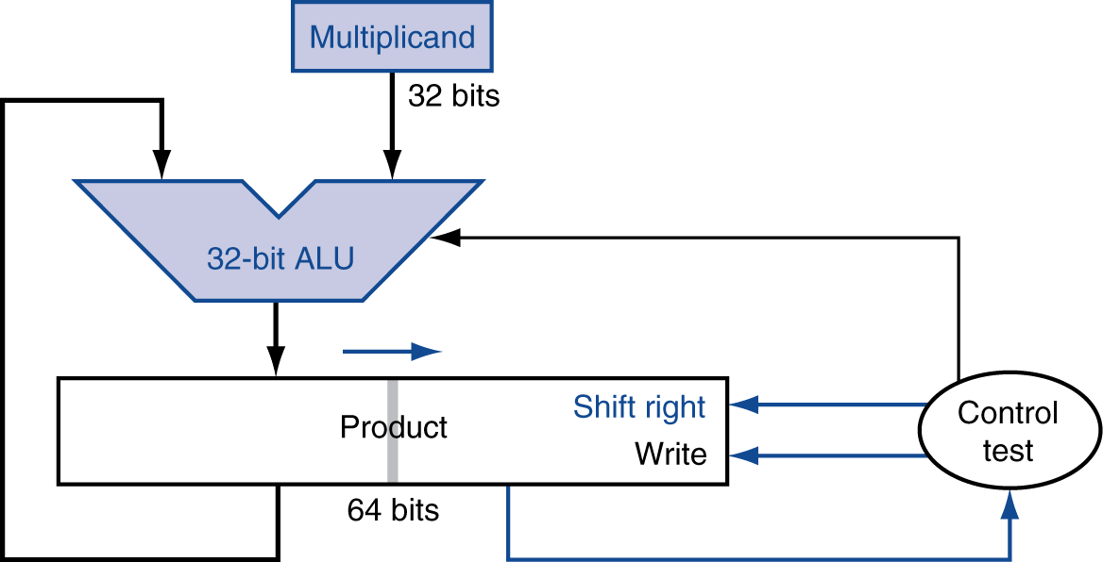
Optimized Multiplier
Perform steps in parallel: add/shift
One cycle per partial-product addition
That’s ok, if frequency of multiplications is low

Slide 10
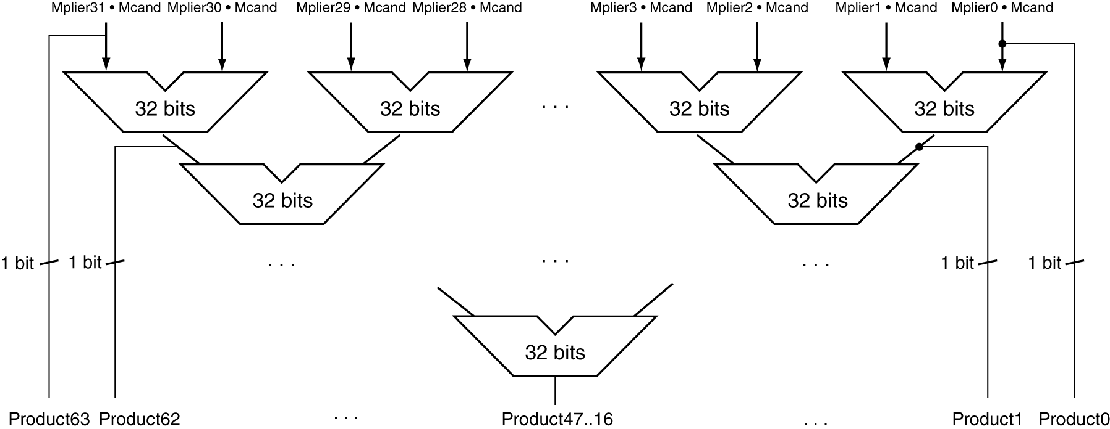
Faster Multiplier
Uses multiple adders
Cost/performance tradeoff
Can be pipelined
Several multiplication performed in parallel

Slide 11
MIPS Multiplication
Two 32-bit registers for product
HI: most-significant 32 bits
LO: least-significant 32-bits
Instructions
mult rs, rt / multu rs, rt
64-bit product in HI/LO
mfhi rd / mflo rd
Move from HI/LO to rd
Can test HI value to see if product overflows 32 bits
mul rd, rs, rt
Least-significant 32 bits of product –> rd

Slide 12
Division
§3.4 Division
Check for 0 divisor
Long division approach
If divisor ≤ dividend bits
1 bit in quotient, subtract
Otherwise
0 bit in quotient, bring down next dividend bit
Restoring division
Do the subtract, and if remainder goes < 0, add divisor back
Signed division
Divide using absolute values
Adjust sign of quotient and remainder as required
quotient
dividend
1001
1000 1001010
-1000
10
101
1010
-1000
10
divisor
remainder
n-bit operands yield n-bit quotient and remainder

Slide 13
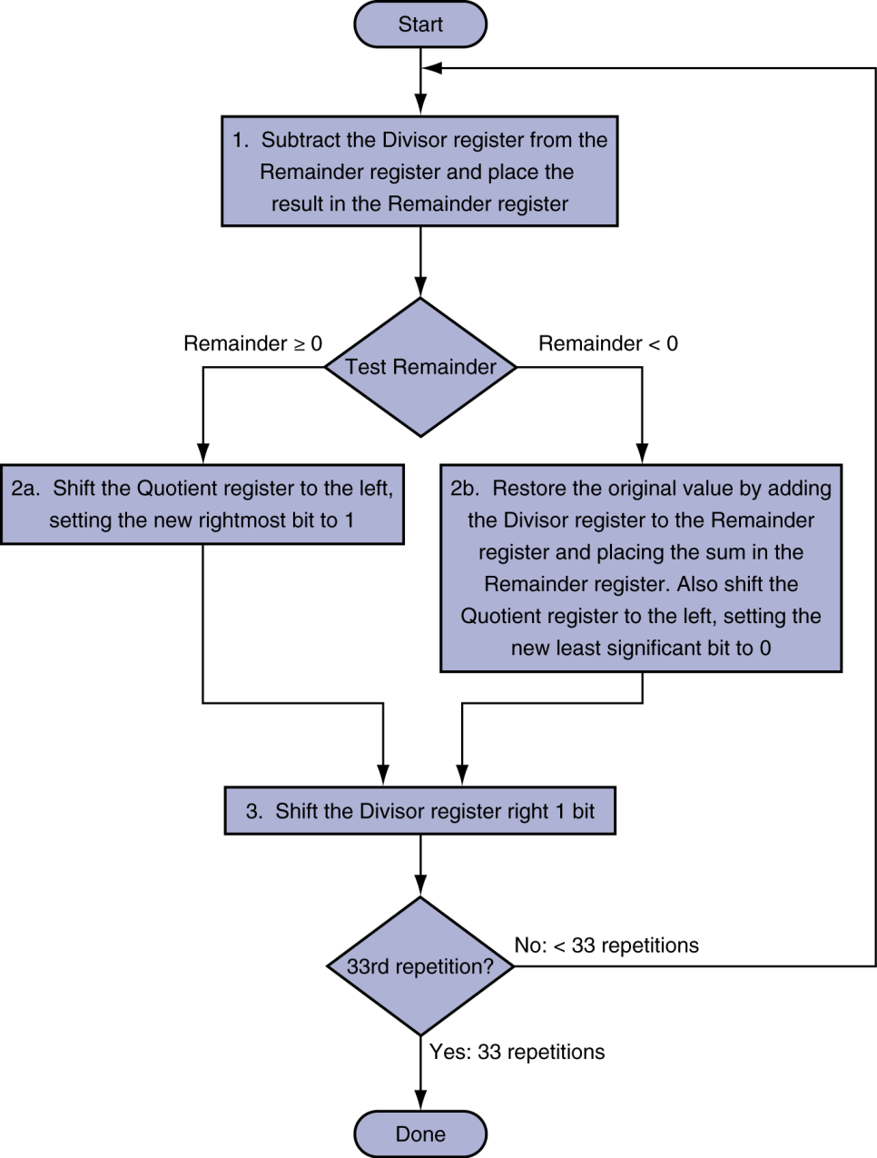
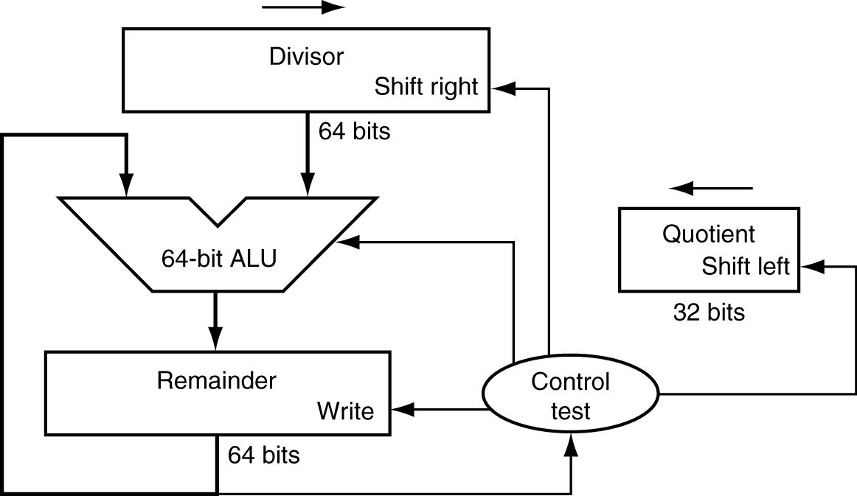
Division Hardware
Initially divisor in left half
Initially dividend

Slide 14
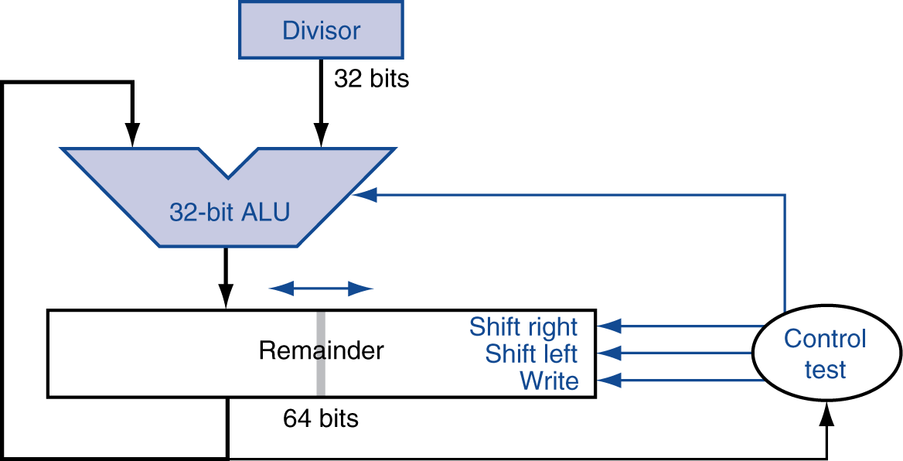
Optimized Divider
One cycle per partial-remainder subtraction
Looks a lot like a multiplier!
Same hardware can be used for both

Slide 15
Faster Division
Can’t use parallel hardware as in multiplier
Subtraction is conditional on sign of remainder
Faster dividers (e.g. SRT devision) generate multiple quotient bits per step
Still require multiple steps

Slide 16
MIPS Division
Use HI/LO registers for result
HI: 32-bit remainder
LO: 32-bit quotient
Instructions
div rs, rt / divu rs, rt
No overflow or divide-by-0 checking
Software must perform checks if required
Use mfhi, mflo to access result

Slide 17
Floating Point
§3.5 Floating Point
Representation for non-integral numbers
Including very small and very large numbers
Like scientific notation
–2.34 × 10⁵⁶
+0.002 × 10^{–4}
+987.02 × 10⁹
In binary
±1.xxxxxxx₂ × 2^{yyyy}
Types float and double in C
normalized
not normalized

Slide 18
Floating Point Standard
Defined by IEEE Std 754-1985
Developed in response to divergence of representations
Portability issues for scientific code
Now almost universally adopted
Two representations
Single precision (32-bit)
Double precision (64-bit)

Slide 19
IEEE
The IEEE updated their floating point standard in 2008 (it’s a superset of the 1985 version)
Not all hardware is IEEE floating point compliant, notably GPU’s, *OR* it will have a compliance mode that is slower than the regular non compliant mode
Just something to keep an eye on when doing real work

Slide 20
IEEE Floating-Point Format
single: 8 bits double: 11 bits
single: 23 bits double: 52 bits
S
Exponent
Fraction
S: sign bit (0 ⇒ non-negative, 1 ⇒ negative)
Normalize significand: 1.0 ≤ |significand| < 2.0
Always has a leading pre-binary-point 1 bit, so no need to represent it explicitly (hidden bit)
Significand is Fraction with the “1.” restored
Exponent: excess representation: actual exponent + Bias
Ensures exponent is unsigned
Single: Bias = 127; Double: Bias = 1203 1023

Slide 21
Single-Precision Range
Exponents 00000000 and 11111111 reserved
Smallest value
Exponent: 00000001 ⇒ actual exponent = 1 – 127 = –126
Fraction: 000…00 ⇒ significand = 1.0
±1.0 × 2^{–126} ≈ ±1.2 × 10^{–38}
Largest value
exponent: 11111110 ⇒ actual exponent = 254 – 127 = +127
Fraction: 111…11 ⇒ significand ≈ 2.0
±2.0 × 2⁺¹²⁷ ≈ ±3.4 × 10⁺³⁸

Slide 22
Double-Precision Range
Exponents 0000…00 and 1111…11 reserved
Smallest value
Exponent: 00000000001 ⇒ actual exponent = 1 – 1023 = –1022
Fraction: 000…00 ⇒ significand = 1.0
±1.0 × 2^{–1022} ≈ ±2.2 × 10^{–308}
Largest value
Exponent: 11111111110 ⇒ actual exponent = 2046 – 1023 = +1023
Fraction: 111…11 ⇒ significand ≈ 2.0
±2.0 × 2⁺¹⁰²³ ≈ ±1.8 × 10⁺³⁰⁸

Slide 23
Floating-Point Precision
Relative precision
all fraction bits are significant
Single: approx 2^{–23}
Equivalent to 23 × log₁₀2 ≈ 23 × 0.3 ≈ 6 decimal digits of precision
Double: approx 2^{–52}
Equivalent to 52 × log₁₀2 ≈ 52 × 0.3 ≈ 16 decimal digits of precision

Slide 24
Floating-Point Example
Represent –0.75
–0.75 = (–1)¹ × 1.1₂ × 2^{–1}
S = 1
Fraction = 1000…00₂
Exponent = –1 + Bias
Single: –1 + 127 = 126 = 01111110₂
Double: –1 + 1023 = 1022 = 01111111110₂
Single: 1011111101000…00
Double: 1011111111101000…00

Slide 25
Floating-Point Example
What number is represented by the single-precision float
11000000101000…00
S = 1
Fraction = 01000…00₂
Exponent = 10000001₂ = 129
x = (–1)¹ × (1 + 01₂) × 2^{(129 – 127)}
= (–1) × 1.25 × 2²
= –5.0

Slide 26
Denormal Numbers
Exponent = 000...0 ⇒ hidden bit is 0
Smaller than normal numbers
allow for gradual underflow, with diminishing precision
Denormal with fraction = 000...0
Two representations of 0.0!

Slide 27
Infinities and NaNs
Exponent = 111...1, Fraction = 000...0
±Infinity
Can be used in subsequent calculations, avoiding need for overflow check
Exponent = 111...1, Fraction ≠ 000...0
Not-a-Number (NaN)
Indicates illegal or undefined result
e.g., 0.0 / 0.0
Can be used in subsequent calculations

Slide 28
Floating-Point Addition
Consider a 4-digit decimal example
9.999 × 10¹ + 1.610 × 10^{–1}
1. Align decimal points
Shift number with smaller exponent
9.999 × 10¹ + 0.016 × 10¹
2. Add significands
9.999 × 10¹ + 0.016 × 10¹ = 10.015 × 10¹
3. Normalize result & check for over/underflow
1.0015 × 10²
4. Round and renormalize if necessary
1.002 × 10²

Slide 29
Floating-Point Addition
Now consider a 4-digit binary example
1.000₂ × 2^{–1} + –1.110₂ × 2^{–2} (0.5 + –0.4375)
1. Align binary points
Shift number with smaller exponent
1.000₂ × 2^{–1} + –0.111₂ × 2^{–1}
2. Add significands
1.000₂ × 2^{–1} + –0.111₂ × 2–1 = 0.001₂ × 2^{–1}
3. Normalize result & check for over/underflow
1.000₂ × 2^{–4}, with no over/underflow
4. Round and renormalize if necessary
1.000₂ × 2^{–4} (no change) = 0.0625

Slide 30
FP Adder Hardware
Much more complex than integer adder
Doing it in one clock cycle would take too long
Much longer than integer operations
Slower clock would penalize all instructions
FP adder usually takes several cycles
Can be pipelined

Slide 31
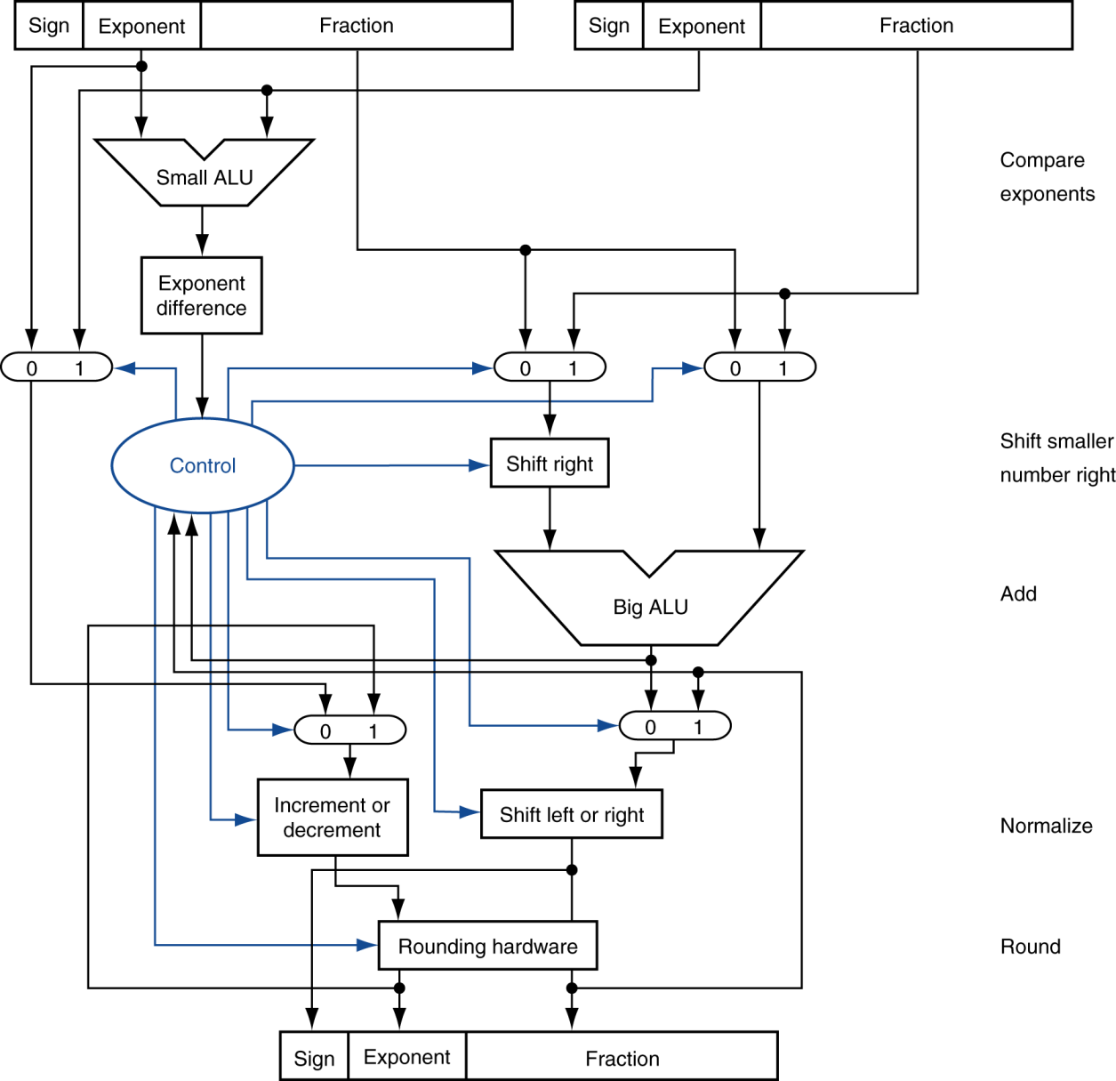
FP Adder Hardware
Step 1
Step 2
Step 3
Step 4

Slide 32
Floating-Point Multiplication
Consider a 4-digit decimal example
1.110 × 10¹⁰ × 9.200 × 10^{–5}
1. Add exponents
For biased exponents, subtract bias from sum
New exponent = 10 + –5 = 5
2. Multiply significands
1.110 × 9.200 = 10.212 ⇒ 10.212 × 10⁵
3. Normalize result & check for over/underflow
1.0212 × 10⁶
4. Round and renormalize if necessary
1.021 × 10⁶
5. Determine sign of result from signs of operands
+1.021 × 10⁶

Slide 33
Floating-Point Multiplication
Now consider a 4-digit binary example
1.000₂ × 2^{–1} × –1.110₂ × 2^{–2} (0.5 × –0.4375)
1. Add exponents
Unbiased: –1 + –2 = –3
Biased: (–1 + 127) + (–2 + 127) = –3 + 254 – 127 = –3 + 127
2. Multiply significands
1.000₂ × 1.110₂ = 1.1102 ⇒ 1.110₂ × 2^{–3}
3. Normalize result & check for over/underflow
1.110₂ × 2^{–3} (no change) with no over/underflow
4. Round and renormalize if necessary
1.110₂ × 2^{–3} (no change)
5. Determine sign: +ve × –ve ⇒ –ve
–1.110₂ × 2^{–3} = –0.21875

Slide 34
FP Arithmetic Hardware
FP multiplier is of similar complexity to FP adder
But uses a multiplier for significands instead of an adder
FP arithmetic hardware usually does
Addition, subtraction, multiplication, division, reciprocal, square-root
FP ↔ integer conversion
Operations usually takes several cycles
Can be pipelined

Slide 35
FP Instructions in MIPS
FP hardware is coprocessor 1
Adjunct processor that extends the ISA
Separate FP registers
32 single-precision: $f0, $f1, … $f31
Paired for double-precision: $f0/$f1, $f2/$f3, …
Release 2 of MIPs ISA supports 32 × 64-bit FP reg’s
FP instructions operate only on FP registers
Programs generally don’t do integer ops on FP data, or vice versa
More registers with minimal code-size impact
FP load and store instructions
lwc1, ldc1, swc1, sdc1
e.g., ldc1 $f8, 32($sp)

Slide 36
FP Instructions in MIPS
Single-precision arithmetic
add.s, sub.s, mul.s, div.s
e.g., add.s $f0, $f1, $f6
Double-precision arithmetic
add.d, sub.d, mul.d, div.d
e.g., mul.d $f4, $f4, $f6
Single- and double-precision comparison
c.xx.s, c.xx.d (xx is eq, lt, le, …)
Sets or clears FP condition-code bit
e.g. c.lt.s $f3, $f4
Branch on FP condition code true or false
bc1t, bc1f
e.g., bc1t TargetLabel

Slide 37
FP Example: °F to °C
C code:
float f2c (float fahr) { return ((5.0/9.0)*(fahr - 32.0)); }
fahr in $f12, result in $f0, literals in global memory space
Compiled MIPS code:
f2c: lwc1 $f16, const5($gp) lwc2 $f18, const9($gp) div.s $f16, $f16, $f18 lwc1 $f18, const32($gp) sub.s $f18, $f12, $f18 mul.s $f0, $f16, $f18 jr $ra

Slide 38
FP Example: Array Multiplication
X = X + Y × Z
All 32 × 32 matrices, 64-bit double-precision elements
C code:
void mm (double x[][], double y[][], double z[][]) { int i, j, k; for (i = 0; i! = 32; i = i + 1) for (j = 0; j! = 32; j = j + 1) for (k = 0; k! = 32; k = k + 1) x[i][j] = x[i][j] + y[i][k] * z[k][j]; }
Addresses of x, y, z in $a0, $a1, $a2, and i, j, k in $s0, $s1, $s2

Slide 39
FP Example: Array Multiplication
MIPS code:
li $t1, 32 # $t1 = 32 (row size/loop end) li $s0, 0 # i = 0; initialize 1st for loop L1: li $s1, 0 # j = 0; restart 2nd for loop L2: li $s2, 0 # k = 0; restart 3rd for loop sll $t2, $s0, 5 # $t2 = i * 32 (size of row of x) addu $t2, $t2, $s1 # $t2 = i * size(row) + j sll $t2, $t2, 3 # $t2 = byte offset of [i][j] addu $t2, $a0, $t2 # $t2 = byte address of x[i][j] l.d $f4, 0($t2) # $f4 = 8 bytes of x[i][j] L3: sll $t0, $s2, 5 # $t0 = k * 32 (size of row of z) addu $t0, $t0, $s1 # $t0 = k * size(row) + j sll $t0, $t0, 3 # $t0 = byte offset of [k][j] addu $t0, $a2, $t0 # $t0 = byte address of z[k][j] l.d $f16, 0($t0) # $f16 = 8 bytes of z[k][j] …

Slide 40
FP Example: Array Multiplication
… sll $t0, $s0, 5 # $t0 = i*32 (size of row of y) addu $t0, $t0, $s2 # $t0 = i*size(row) + k sll $t0, $t0, 3 # $t0 = byte offset of [i][k] addu $t0, $a1, $t0 # $t0 = byte address of y[i][k] l.d $f18, 0($t0) # $f18 = 8 bytes of y[i][k] mul.d $f16, $f18, $f16 # $f16 = y[i][k] * z[k][j] add.d $f4, $f4, $f16 # f4=x[i][j] + y[i][k]*z[k][j] addiu $s2, $s2, 1 # $k k + 1 bne $s2, $t1, L3 # if (k != 32) go to L3 s.d $f4, 0($t2) # x[i][j] = $f4 addiu $s1, $s1, 1 # $j = j + 1 bne $s1, $t1, L2 # if (j != 32) go to L2 addiu $s0, $s0, 1 # $i = i + 1 bne $s0, $t1, L1 # if (i != 32) go to L1

Slide 41
Accurate Arithmetic
IEEE Std 754 specifies additional rounding control
Extra bits of precision (guard, round, sticky)
Choice of rounding modes
Allows programmer to fine-tune numerical behavior of a computation
Not all FP units implement all options
Most programming languages and FP libraries just use defaults
Trade-off between hardware complexity, performance, and market requirements

Slide 42
Subword Parallellism
Graphics and audio applications can take advantage of performing simultaneous operations on short vectors
Example: 128-bit adder:
Sixteen 8-bit adds
Eight 16-bit adds
Four 32-bit adds
Also called data-level parallelism, vector parallelism, or Single Instruction, Multiple Data (SIMD)
§3.6 Parallelism and Computer Arithmetic: Subword Parallelism

Slide 43
x86 FP Architecture
Originally based on 8087 FP coprocessor
8 × 80-bit extended-precision registers
Used as a push-down stack
Registers indexed from TOS: ST(0), ST(1), …
FP values are 32-bit or 64 in memory
Converted on load/store of memory operand
Integer operands can also be converted on load/store
Very difficult to generate and optimize code
Result: poor FP performance
§3.7 Real Stuff: Streaming SIMD Extensions and AVX in x86

Slide 44
x86 FP Instructions
Data transfer | Arithmetic | Compare | Transcendental
FILD mem/ST(i) FISTP mem/ST(i) FLDPI FLD1 FLDZ | FIADDP mem/ST(i) FISUBRP mem/ST(i) FIMULP mem/ST(i) FIDIVRP mem/ST(i) FSQRT FABS FRNDINT | FICOMP FIUCOMP FSTSW AX/mem | FPATAN F2XMI FCOS FPTAN FPREM FPSIN FYL2X
Optional variations
I: integer operand
P: pop operand from stack
R: reverse operand order
But not all combinations allowed

Slide 45
Streaming SIMD Extension 2 (SSE2)
Adds 4 × 128-bit registers
Extended to 8 registers in AMD64/EM64T
Can be used for multiple FP operands
2 × 64-bit double precision
4 × 32-bit double precision
Instructions operate on them simultaneously
Single-Instruction Multiple-Data

Slide 46
Matrix Multiply
Unoptimized code:
1. void dgemm (int n, double* A, double* B, double* C)
2. {
3. for (int i = 0; i < n; ++i)
4. for (int j = 0; j < n; ++j)
5. {
6. double cij = C[i+j*n]; /* cij = C[i][j] */
7. for(int k = 0; k < n; k++ )
8. cij += A[i+k*n] * B[k+j*n]; /* cij += A[i][k]*B[k][j] */
9. C[i+j*n] = cij; /* C[i][j] = cij */
10. }
11. }
§3.8 Going Faster: Subword Parallelism and Matrix Multiply
Notes:
Dgemm -> Double precision general matrix multiply

Slide 47
https://software.intel.com/en-us/mkl-tutorial-c-multiplying-matrices-using-dgemm

Slide 48
Matrix Multiply
x86 assembly code:
1. vmovsd (%r10),%xmm0 # Load 1 element of C into %xmm0
2. mov %rsi,%rcx # register %rcx = %rsi
3. xor %eax,%eax # register %eax = 0
4. vmovsd (%rcx),%xmm1 # Load 1 element of B into %xmm1
5. add %r9,%rcx # register %rcx = %rcx + %r9
6. vmulsd (%r8,%rax,8),%xmm1,%xmm1 # Multiply %xmm1, element of A
7. add $0x1,%rax # register %rax = %rax + 1
8. cmp %eax,%edi # compare %eax to %edi
9. vaddsd %xmm1,%xmm0,%xmm0 # Add %xmm1, %xmm0
10. jg 30 <dgemm+0x30> # jump if %eax > %edi
11. add $0x1,%r11d # register %r11 = %r11 + 1
12. vmovsd %xmm0,(%r10) # Store %xmm0 into C element
§3.8 Going Faster: Subword Parallelism and Matrix Multiply

Slide 49
Matrix Multiply
Optimized C code:
1. #include <x86intrin.h>
2. void dgemm (int n, double* A, double* B, double* C)
3. {
4. for ( int i = 0; i < n; i+=4 )
5. for ( int j = 0; j < n; j++ ) {
6. __m256d c0 = _mm256_load_pd(C+i+j*n); /* c0 = C[i][j] */
7. for( int k = 0; k < n; k++ )
8. c0 = _mm256_add_pd(c0, /* c0 += A[i][k]*B[k][j] */
9. _mm256_mul_pd(_mm256_load_pd(A+i+k*n),
10. _mm256_broadcast_sd(B+k+j*n)));
11. _mm256_store_pd(C+i+j*n, c0); /* C[i][j] = c0 */
12. }
13. }
§3.8 Going Faster: Subword Parallelism and Matrix Multiply

Slide 50
Matrix Multiply
Optimized x86 assembly code:
1. vmovapd (%r11),%ymm0 # Load 4 elements of C into %ymm0
2. mov %rbx,%rcx # register %rcx = %rbx
3. xor %eax,%eax # register %eax = 0
4. vbroadcastsd (%rax,%r8,1),%ymm1 # Make 4 copies of B element
5. add $0x8,%rax # register %rax = %rax + 8
6. vmulpd (%rcx),%ymm1,%ymm1 # Parallel mul %ymm1,4 A elements
7. add %r9,%rcx # register %rcx = %rcx + %r9
8. cmp %r10,%rax # compare %r10 to %rax
9. vaddpd %ymm1,%ymm0,%ymm0 # Parallel add %ymm1, %ymm0
10. jne 50 <dgemm+0x50> # jump if not %r10 != %rax
11. add $0x1,%esi # register % esi = % esi + 1
12. vmovapd %ymm0,(%r11) # Store %ymm0 into 4 C elements
§3.8 Going Faster: Subword Parallelism and Matrix Multiply

Slide 51
Right Shift and Division
Left shift by i places multiplies an integer by 2^{i}
Right shift divides by 2^{i}?
Only for unsigned integers
For signed integers
Arithmetic right shift: replicate the sign bit
e.g., –5 / 4
11111011₂ >> 2 = 11111110₂ = –2
Rounds toward –∞
c.f. 11111011₂ >>> 2 = 00111110₂ = +62
§3.9 Fallacies and Pitfalls

Slide 52
Associativity
Parallel programs may interleave operations in unexpected orders
Assumptions of associativity may fail
Need to validate parallel programs under varying degrees of parallelism

Slide 53
Who Cares About FP Accuracy?
Important for scientific code
But for everyday consumer use?
“My bank balance is out by 0.0002¢!” ☹
The Intel Pentium FDIV bug
The market expects accuracy
See Colwell, The Pentium Chronicles

Slide 54
Concluding Remarks
Bits have no inherent meaning
Interpretation depends on the instructions applied
Computer representations of numbers
Finite range and precision
Need to account for this in programs
§3.9 Concluding Remarks

Slide 55
Concluding Remarks
ISAs support arithmetic
Signed and unsigned integers
Floating-point approximation to reals
Bounded range and precision
Operations can overflow and underflow
MIPS ISA
Core instructions: 54 most frequently used
100% of SPECINT, 97% of SPECFP
Other instructions: less frequent

